Slide 1
Tuesday, November 26, 2019
FRICTION IN FLUIDS - VISCOSITY
Michael Adeleye, Ph.D, P.G. Dip.Ed.

Slide 2
Contents
Friction in fluids
Drag on objects falling through a viscous fluid
Terminal velocity for solids falling through a fluid
Experimental determination of terminal velocity
Effects of viscosity
Applications of viscosity
Lubrication

Slide 3
Learning objectives
At the end of the lesson you should be able to:
Define viscosity
Describe experiment to determine terminal velocity
Compare viscosities of various liquids
List applications of viscosity
Explain effect of temperature & pressure on lubrication

Slide 4
Previous knowledge
Contact & force fields
Newton’s laws of motion
Friction between solid surfaces
Resultant & components of forces
Fluid mechanics
Effect of friction on efficiency of machines

Slide 5
Definition
Friction is a force that opposes the relative
sliding motion of two surfaces in contact with
one another.
Friction slows down or prevents motion.

Slide 6
Advantages of Friction - all friction is not ‘evil’
It enables us to walk and run, without it we would slip particularly when we try to move on slippery surface such as wet floor.
Pattern of tyre thread are designed to prevent accident particularly on wet roads by providing a firm grip. The grooves clear away water on wet road which could reduce traction between the tyre and road.
The frictional force between the wheel and brake blocks in the brake linings of automobiles slows down on the wheels.
Notes:
Nowadays, there are re-groovable tyres for trucks.

Slide 7
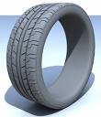
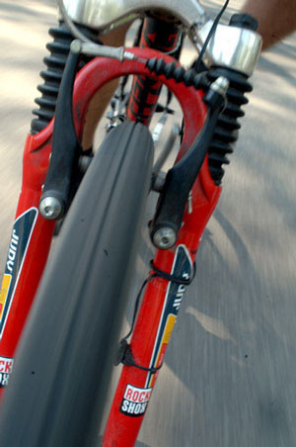
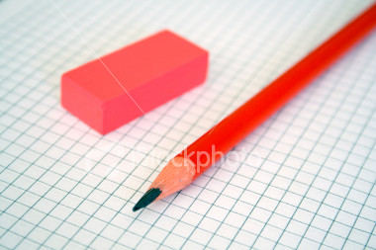

Advantages of friction
Pattern on tyre thread
Pencil & eraser
Brakes on a bike
Ski’s on the snow

Slide 8
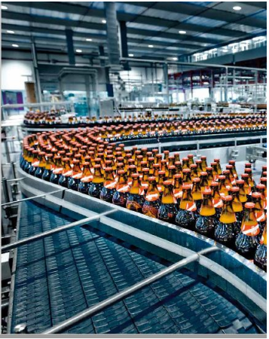
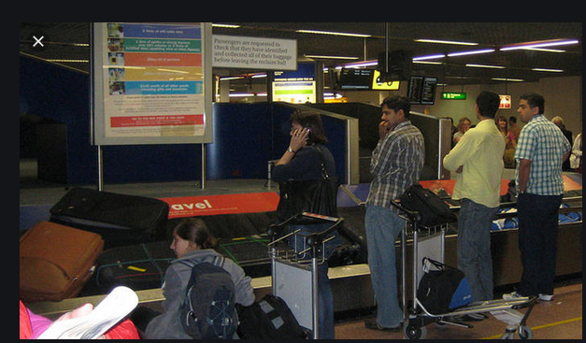
Advantages of friction
Friction is used in friction belt or belt drive used in machines e.g. fan belt of car engine, conveyor in bottling companies or pharmaceuticals for packaging, airport baggage transportation etc.
Conveyor in bottling companies
Airport baggage carousel

Slide 9
Advantages of friction
A household application of friction is the production of heat between the match stick and the box when struck, this heat generated ignites the inflammable substance on the match stick and subsequently the match stick itself. Same thing in cigarette lighter.

Slide 10
Advantages of friction
Friction (air drag) acts as life saver in parachute and skydiving.
Friction helps nuts and bolts to stay tight.
Friction prevents ladder from slipping.
Without air drag, raindrops and snowballs will not attain terminal velocity hence will hit us at a dangerously high speed and momentum.
Sharpening of blunt cutlasses and knife with stones depends on friction.
Grinding of pepper with grinding stones for an African housewife.

Slide 11
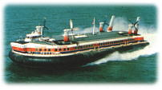
Disadvantages of friction
Friction causes wear and tear of parts of a machine rubbing against each other.
Friction generates unwanted heat in machines.
Friction reduces the efficiency of machines because part of the energy supplied into it is used in overcoming friction. (Dissipation of energy as heat) Some parts of a machine may also seize or weld together as a result of friction. In extreme cases, it could lead to fire outbreak.
Friction reduces speed of moving objects.

Slide 12
Disadvantages of friction
Friction damps oscillation i.e. Progressively reduces amplitude of oscillation e.g. Simple pendulum due to air resistance.
Friction causes unwanted noise in machines.

Slide 13
Methods of reducing friction
Lubrication – Applying lubricating oil or grease between metal surfaces rubbing against each other e.g. engine oil of different grades to keep engine running smoothly.
Use of ball or roller bearings where a wheel is turning on an axle.
Fluid friction is reduced by streamlining of ships travelling in water and airplane in air. Cars are also streamlined to reduce the drag or air resistance.
Smoothening of surfaces.
Create a cushion of air
Eg. Like a hovercraft or dynamic cart.
Notes:
Streamline - design or build something with a smooth shape and minimize total surface area so that it moves with minimum resistance through air or water. Bodies usually streamlined includes cars, boats & airplanes.

Slide 14
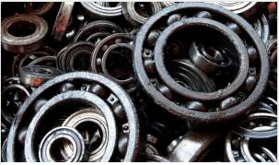
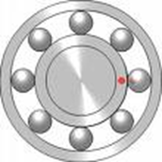
Ball bearings in cars

Slide 15
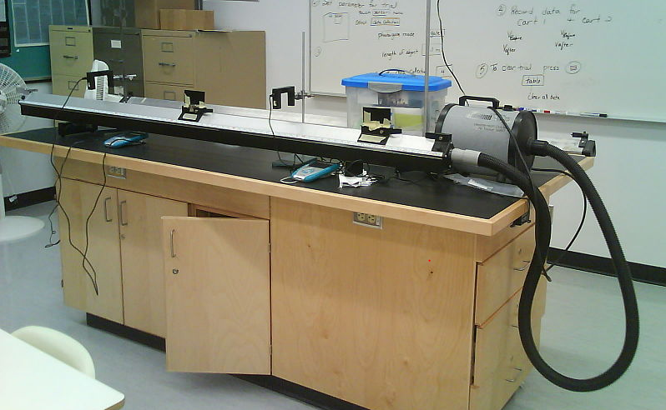
Create a cushion of air on a dynamic cart
Dynamic cart - A frictionless air track shows the inertia of motion. Description - A glider is placed on an air track and is given a push. It maintains a visibly near constant velocity for a very long time.

Slide 16
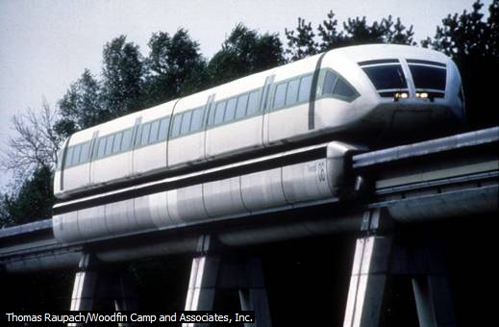
Magnetic Levitation Train (Maglev)
Magnetic levitation (magnetic suspension system without
friction) and superconductivity gave birth to Maglev trains.
Magnetic levitation trains levitate above the track by means of a magnetic suspension system, thus reducing or eliminating vibration, friction, and noise.
Magnetic levitation trains can reach extremely high speeds. This experimental train in Germany reaches 435 km/hr (270 mph).

Slide 17
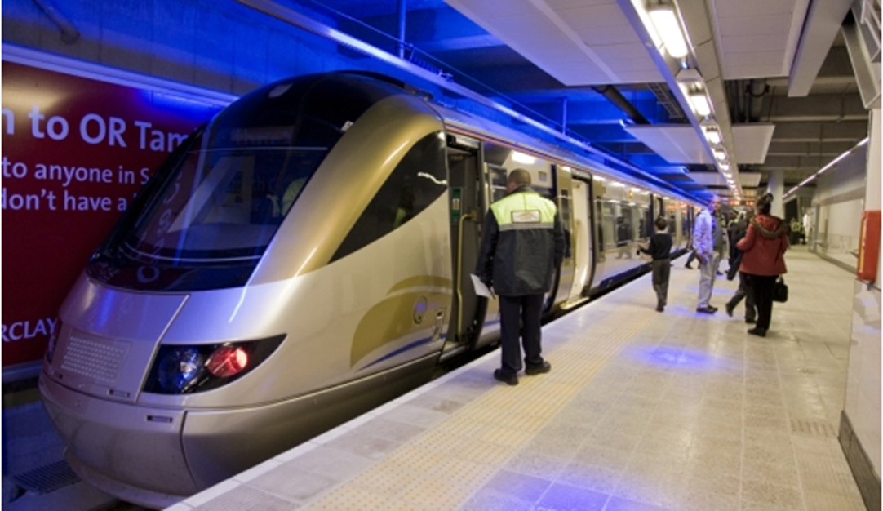
Africa's first high speed train at OR Tambo International Airport, Jo’burg
Just in time for the 2010 world cup.
Notes:
Imagine high-speed passenger train or cargo train going from Abuja to Lagos in less than 2 hours!

Slide 18
Viscosity – Friction in fluids
Viscosity is a measure of fluid friction and it is
the property of a fluid which tends to
oppose/prevent motion of one layer of
fluid over another layer.
Highly viscous materials are those that possess
a great deal of internal friction when layers are
in relative motion. They cannot be spread or
poured as easily as less viscous materials.
Higher pressure difference is needed between the two
ends of a pipe to maintain a steady flow of a viscous fluid.
Notes:
Viscous fluids cannot be spread or poured as easily. Flow slowly.

Slide 19

Viscosity – Internal friction of a fluid
Real fluids have a certain amount of internal
friction which tends to oppose motion of one
layer of fluid over another layer as they move
past one another.
When a viscous fluid flows in a stationary tube or
pipe, the flow velocity is different at different
points of a cross section. The velocity is greatest
at the centre and decreases to zero at the walls.
Velocity distribution for viscous flow

Slide 20
Viscosity – Internal Friction of a fluid
When a fluid, either a liquid or a gas, is set in motion, different parts of the fluid move with different velocities. Just as there is friction when one surface of a solid slides over another, so there is friction when one layer of a fluid slides over another. This friction in fluids is called viscosity.
When a fluid flows through a cylindrical pipe, the part of the fluid in contact with the pipe adheres to it and remains at rest. We may think of the rest of the fluid as divided into concentric cylindrical layers, the velocity of each succeeding inner layer increasing as we go to the center.
A difference in pressure between the two ends of the pipe is needed to maintain a steady flow through it and oppose the force due to the viscosity of the fluid.
Velocity distribution for viscous flow
Notes:
The resistance experienced by a solid moving through a fluid is due essentially to the viscosity of the fluid. A certain amount of fluid adheres to the surface of the solid and moves with it, and this layer drags along an adjacent layer and so on, until, at sufficiently large distance from the solid, the fluid is at rest. Some of the momentum of the solid has been given up to setting the fluid in motion, and if no external force is applied, the solid will come to rest. An additional cause of the resistance experienced by objects moving through fluids is the turbulence set up in the fluid.

Slide 21
Factors affecting viscosity
The coefficient of viscosity of liquids decreases
with an increase in temperature while in the
case of gases, the coefficient of viscosity
increases with increasing temperature.
The most important thing in lubrication theory is
that viscosity changes very strongly with
temperature and pressure.
Viscosity is measured in stokes using viscometer.

Slide 22
Fluid Friction and Motion
Description qualitatively of the motion of bodies falling in a uniform gravitational field with fluid resistance.
Refer back to non-uniformly accelerated motion.
Discussion of ideas of unbalanced forces followed by balanced forces
Terminal velocity.

Slide 23
Experiment to determine terminal velocity of a steel ball falling through a jar of glycerine.
t₁
T₁
Mark out 10cm distances along the tube of glycerine using small elastic bands, time the fall of the steel ball each through 10cm; 20cm; 30cm etc
Plot a graph of v against T for 1 to 9.
9 people are equipped with timers, a 10th person carefully drops a steel ball bearing into the glycerine oil, as the ball passes each line that timer is stopped in turn. Hence you record T₁ through T₉. All the timers are started simultaneously as the ball enters the glycerine. Subtraction will give the time for each section t₁ through t₉. The velocity v₁ to v₉ for each section can then be found.
t₂
T₂
t₃
T₃
t₄
T₄
t₅
T₅
t₆
T₆
t₇
T₇
t₈
T₈
t₉
T₉
Notes:
Resources: Perspex tubes, plasticine, stop watches, small elastic bands. Precaution: Make sure bung is securely in bottom of tube.

Slide 24
Identify all forces acting on the body and determine the resultant Sketch graphs: s-t and v-t [slopes of s-t graphs] and analyse the motion Graphical representation of terminal velocity
Analysis of motion of a solid body falling through a viscous fluid

Slide 25
Sketch vel-time and acc-time graphs for a body falling from rest (i) in a vacuum (ii) through the air at the same place near the Earth’s surface.
Quick Class Exercise

Slide 26
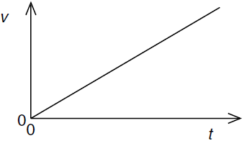
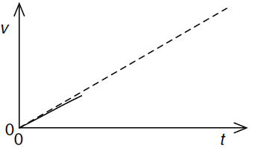
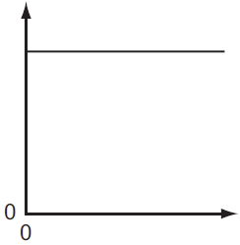
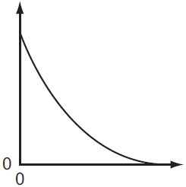
Result of Quick Class Exercise
In a vacuum
Through the air
Notes:
Initially the object will be accelerated by gravity since there is initially no drag since the initial velocity is zero. As the vertical downwards velocity builds the drag force increases until eventually the forces are balanced and a terminal velocity is reached.

Slide 27

Solid body falling through a viscous fluid and terminal velocity
An object of mass m falling through a fluid will experience force of gravity F_{g}, negligible buoyant force F_{B} and the drag force F_{D}.
By Newton’s second law, the net force is given by F_{g} – (F_{B} + F_{D}) = ma
or F_{g} – F_{D} = ma since the buoyant force F_{B} is negligible.
The size of this viscous (drag) force F_{D} is directly proportional to the speed v of the object. So F_{D} = kv
Therefore the equation could be written as F_{g} – kv = ma
Notes:
Note:The viscous (drag) force F_{D} is directly proportional to the speed v of the object. (approximately, but really also to higher powers of v)

Slide 28
Solid body falling through a viscous fluid and terminal velocity
Initially the object will be accelerated by gravity since there is initially no drag when the initial velocity v is zero. (Then F_{g} ≈ ma, from F_{g} – kv = ma)
But as the object falls, the vertical downwards velocity v increases, the drag force kv also increases until eventually the magnitude (size) of the drag force equals the size of the force of gravity, then the forces are balanced and the object will no longer accelerate, a constant velocity will have been reached. We call this the “terminal velocity”
That is when (F_{g} = kv), then F_{g} – kv = 0, so ma = 0, implying a = 0, and vel v = constant.
Notes:
Note:The viscous (drag) force F_{D} is directly proportional to the speed v of the object. (approximately, but really also to higher powers of v)

Slide 29
Solid body falling through a viscous fluid and terminal velocity
At this point, the acceleration is zero and the speed increases no further.
This maximum speed V_{T} attained is called the terminal velocity.
Notes:
Note:The viscous (drag) force F_{D} is directly proportional to the speed v of the object. (approximately, but really also to higher powers of v)

Slide 30
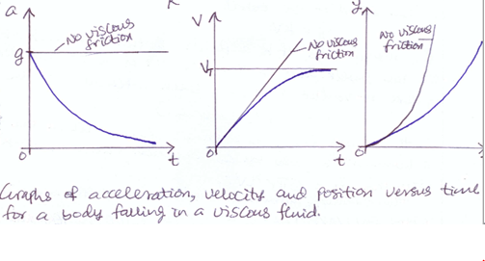
Acceleration-time, velocity-time & displacement-time graphs for a body falling through a viscous fluid
Notes:
Note:The viscous (drag) force F_{D} is directly proportional to the speed v of the object. (approximately, but really also to higher powers of v)

Slide 31
What is responsible for the resistance experienced by solid body moving through viscous fluid? Relate this to the experience of wading through water.
Quick Concept Question

Slide 32
The resistance experienced by a solid moving through a fluid is due essentially to the fact that some of the momentum of the solid has been given up to setting the fluid in motion. An additional cause of the resistance experienced by objects moving through fluids is the turbulence set up in the fluid behind the object at high speeds.
Answer to Quick Concept Question

Slide 33
Class Activity 2
Comparison of viscosities of glycerine (glycerol)
and water by allowing a small steel ball to fall
vertically down the centre of 1m length tube
containing the liquids and then measuring the
time taken from which the average velocities
are determined.
Note: Honey could be used in place of glycerine.
Notes:
Honey could be used in place of glycerine.

Slide 34
Effects of viscosity
Viscosity is what is responsible for the different rates of flow of fluids.
Viscosity affects motion of bodies in fluids. (e.g. ships and aircrafts)

Slide 35
Applications of viscosity
The knowledge of viscous drag is applied in the design of ships and aircrafts.
(Man’s attempt at imitating special adaptation of fish and birds respectively)
Used in the design of parachute.
Viscous liquids are used as lubricants.
Note: Synovial fluid serves as a lubricant during
movement, it allows free movement of the
bones meeting at the joint in human body.

Slide 36
Factors affecting terminal velocity
The shape:
The more streamlined and the smaller the surface area of the body the higher the terminal velocity
The Viscosity of the fluid:
The thicker, (more viscous) the fluid is the lower the terminal velocity

Slide 37

Parachute
Terminal velocity problems are often applied to
falling objects (Freefall Parachutists for example)

Slide 38


Skydiving with parachute (Playing dangerously!)
An Australian woman died in a base jumping accident in Malaysia, after her parachute failed to open!
Tantiky Lie Marion, 42, was conducting a practise jump from a 165-metre tall communications tower in the Malaysian city of Alor Setar in 2011.

Slide 39
Advantages of viscosity
Viscosity (air drag) acts as life saver in parachute and skydiving.
Without air drag, raindrops and snowballs will not attain terminal velocity hence will hit us at a dangerously high speed and momentum.

Slide 40
Disadvantages of viscosity
Viscosity reduces speed of moving objects in viscous fluids.
Viscosity damps oscillation i.e. Progressively reduces amplitude of oscillation e.g. Simple pendulum due to air resistance.
Viscosity generates unwanted heat for fluids in motion.
Viscosity reduces the efficiency of machines because part of the energy supplied into it is used in overcoming friction.

Slide 41
Recap
What is drag force?
A force opposing the motion of an object due to fluid (e.g. air) flowing past the object as it moves.

Slide 42
Recap
What is terminal velocity?
The constant (maximum) velocity reached by an object moving through a viscous fluid.

Slide 43
Recap
What does it mean to streamline?
To design or build something with a smooth shape (and minimum surface area) so that it moves with minimum resistance through fluid (e.g. air or water).

Slide 44
Recap
List examples of streamlined bodies?
Cars, boats & airplanes.

Slide 45
Assignment
Study the functions of
Synovial fluid,
ligaments,
cartilage and
muscles in the human body.

Slide 46
Problem-solving

